Slide 1
NOAA
By:
Sean Kotowich & Adriana Solano

Slide 2

What is NOAA?
National Oceanic & Atmospheric Administration
Ancestors:
U.S. Coast Survey - 1807
U.S. Weather Bureau - 1870
U.S. Commission of Fish and Fisheries - 1871
Present in every state and U.S. territory
U.S. recognized as world leader in different sciences.

Slide 3

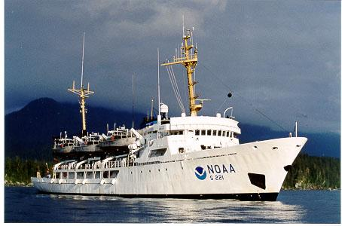

What does NOAA Do?

Slide 4

The Future
GOES-R
March 2016
Western Hemisphere
22,000 miles

Slide 5
Satellite Benefits
What’s the weather going to be?
More detailed and accurate readings
Backbone of NWS
More, Better, Faster!
Three times more data
Better resolution
Five times faster coverage
A REAL life-saver
Forecasts will be timelier, with more “real-time”
Having and keeping electricity flowing is a big deal.
Monitoring space weather
Satisfying the inner-geek
3.5 terabytes of data per day

Slide 6
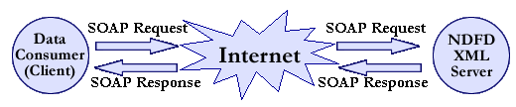
Data
NDFD (National Digital Forecast Database)
NCDC (National Climatic Data Center)

Slide 7
What Is SOAP?
Simple Object Access Protocol
Set of rules for structuring messages that can be used for simple one-way messaging
Developed by Microsoft
Difficulty relies on language used
Relies on xml (Extensible Markup Language)
Provides error handling

Slide 8
Sample Soap Request
http://api-portal.anypoint.mulesoft.com/noaa/api/noaa-national-weather-service-nws-api/docs/reference/ndfd-xml-soap-service?ref=apihub

Slide 9
What Is REST?
Representational State Transfer
Lightweight
Works in multiple languages
Uses http methods
Does not require XML
Returns information in the form of JSON, CSV, or RSS

Slide 10
Sample REST Request
http://graphical.weather.gov/xml/sample_products/browser_interface/ndfdXML.htm

Slide 11
CASE STUDIES

Slide 12
NOAA’s new GIS Platform will increase Availability of Ocean and Weather Data Applications
NOAA signs agreement with Esri, the world leader in GIS technology - Redlands, California
NOAA maintains data quality while building GIS platform.
‘’NOAA has the ability to increase access to Esri software and services - let NOAA data and applications available to all partners”.
NOAA now has unlimited access to Esri desktop and server products, like:
ArcGIS for Desktop
ArcGIS Spatial Analyst and 3D Analyst extensions.
ArcGIS for Maritime.
NOAA now has the benefit to subscribe to Esri’s ArcGIS online.

Slide 13
ArcGIS for Desktop
Compile and manage data
Work with advanced maps
Perform spatial analysis
Conduct GIS projects (Geographical information system)

Slide 14
Overview of Agreement (ELA)
Reduce complexity
Unite software licensing into a single organization-wide agreement
Optimize technology spending
Lower the costs of software compliance and asset management
Increase flexibility
Build a scalable system that aligns with your business objectives
Maximize value
Provide mapping and GIS services where it’s needed; when it’s needed

Slide 15
GIS - Esri
The Power of Mapping
Geographic information system - let us visualize, question, analyze, and interpret data.
How it works?
http://www.esri.com/what-is-gis/howgisworks
http://www.esri.com/what-is-gis/showcase

Slide 16



Other Mashups
GetOutCast
DGMapper
Blizzalert
WeatherMole
Tidespy

Slide 17
Works Cited
“NOAA National Weather Service (NWS).” ProgrammableWeb. Web. 20 Mar.
2015.
“We Need Your Help!” NOAA. Web. 18 Mar. 2015
Shields, Barbara. “NOAA and Esri Agreement to Broaden Understanding of
Environmental Change.” NOAA and Esri Agreement to Broaden
Understanding of Environmental Change. Esri, 27 Feb. 2014. Web. 20 Mar. 2015

